Slide 1

B-Tech Project
Dept. of Computer Science and Engineering
IIT Jodhpur, April 2019
Part-Of-Speech Tagger for Hindi Language
Shashwat Kathuria, Shreyas Mahajan
Under guidance of Prof. Gaurav Harit

Slide 2
Outline
Motivation
Introduction to POS Tagging
Challenges
Hindi POS Tagger - Methodology, Algorithms and Optimization
Results and Analysis
Future Work

Slide 3
Motivation
260 million native speakers
Rank 4
Most spoken
first language
POS Tagger is basic building block for various NLP tools
Less work done in generating and improving Hindi POS Taggers
Wide Applications - Information retrieval, Machine Translation, Word Sense Disambiguation, Question Answering System etc

Slide 4
Complex Situations in POS Tagging
Following are the most common barriers faced while POS Tagging:
Ambiguity
Sparse Data

Slide 5
Challenges faced - Ambiguity
खाना
इस होटल में अच्छा खाना मिल सकता है।
Noun (Food)
पैसा खाना बुरी बात है |
Verb (To eat)
Solution:
This problem can be resolved by looking at the word/tag combinations of surrounding words with respect to the ambiguous word

Slide 6
Challenges faced - Data Sparsity
When with a new word ‘w’, we never have seen any tag.
Hence: for all tags t ∈ T: P( w | t ) = 0
Solution:
To capture the fact that some POS classes are more likely to generate unknown words, we can simply use good smoothing techniques on P(w|t)

Slide 7
Types of POS Taggers
POS-tagging algorithms fall into two distinctive groups:
Rule Based POS Taggers
Stochastic POS Taggers

Slide 8
Rule Based POS Taggers
Typical rule-based approaches use contextual information to assign tags to unknown or ambiguous words. Disambiguation is done by analyzing the linguistic features of the word, its preceding word, its following word, and the context it is in.
Defining a set of rules manually is an extremely cumbersome process and is not scalable at all. So we need some automatic way of doing this.
Issue:

Slide 9
Stochastic POS Taggers
The term ‘stochastic tagger’ can refer to any number of different approaches to the problem of POS tagging. Any model which somehow incorporates frequency or probability can be labelled stochastic.
Probabilities and frequencies can be found out for any dataset. Data can be further improved based on the frequencies observed.
Advantage:

Slide 10
Hidden Markov Model (HMM)
Hidden Markov Model is a combination of two approaches -
Word frequency measurements
Tag sequence probabilities
Transition Probability
T1
T2
T3
T4
Emission Probability
W1
W2
W3
W4

Slide 11
Probabilistic automata
Emission probabilities, which represent the probabilities of making certain observations given a particular state.
Transition probabilities, which represent the probability of transitioning to another state given a particular state.
Transition Probability
T3
T4
Emission Probability
W3
W4

Slide 12
HMM for POS tagging
In POS Tagging, we are interested in finding a tag sequence which maximizes
P ( Tag sequence of length T | Word sequence of length T )
Unfortunately we need a lot of statistical data to reasonably estimate such sequences. However, we can apply some mathematical transformations and use some assumptions to simplify the problem.

Slide 13
Use of Bayes’ Rule
Maximize
P(t | w)
Maximize P(t) * P(w | t)
P(w)
Maximize
P(t)*P(w | t)
Denominator is constant

Slide 14
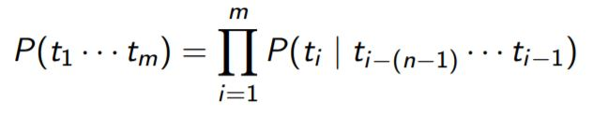
Contextual Independence
The probability of a tag depends on the previous one (bigram model) or
previous two (trigram model) or in general previous n - 1 tags (n-gram model)
The beginning of a sentence can be accounted for by assuming an initial probability for each tag

Slide 15
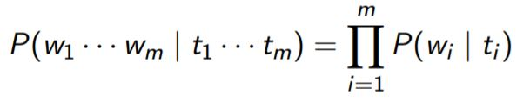
Lexical Independence
The conditional probability can be approximated by assuming that a word appears in a category independent of the words in the preceding or succeeding categories.
It is known as Word Generation Probability

Slide 16
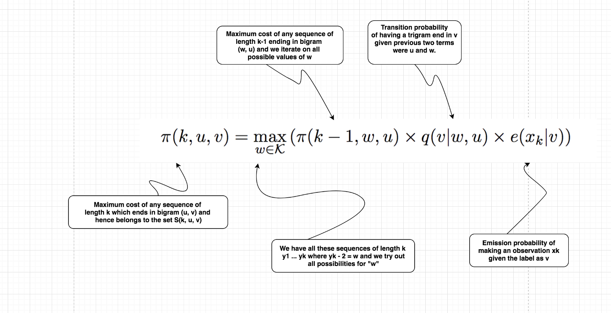
Kinds of Probabilities
Trigram HMM
Viterbi’s
Algorithm

Slide 17
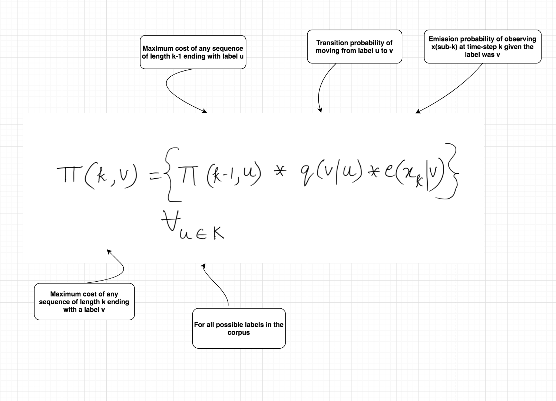
Kinds of Probabilities
Bigram HMM
Viterbi’s
Algorithm

Slide 18
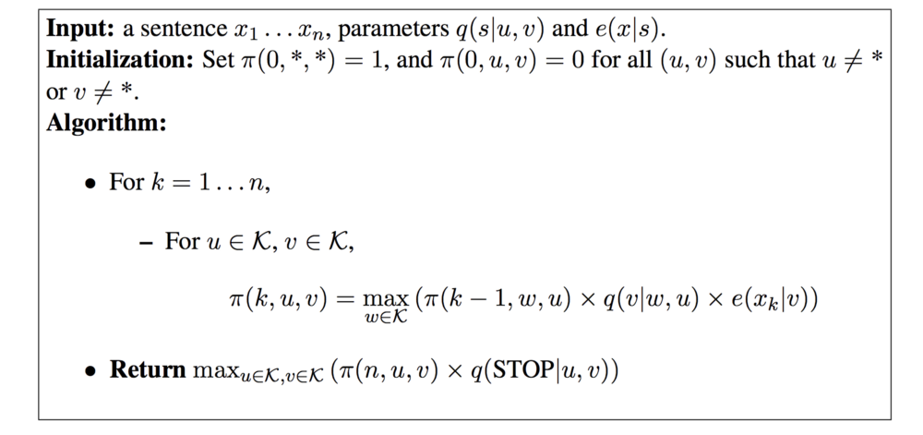
Pseudocode of Algorithm

Slide 19
More on Viterbi Algorithm...
Viterbi Algorithm not only helps us find the π(k) values, that is the cost values for all the sequences using the concept of dynamic programming, but it also helps us to find the most likely tag sequence given a start state and a sequence of observations.
Brute-force Approach | Viterbi Algorithm
Time Complexity: O(|k|^n) Exponential with respect to n Slower for larger n Considers all possible sequences | Time Complexity: O(n*|k^3|) (Trigram) Linear with respect to n, Cubic with k Faster for larger n Uses dynamic programming

Slide 20
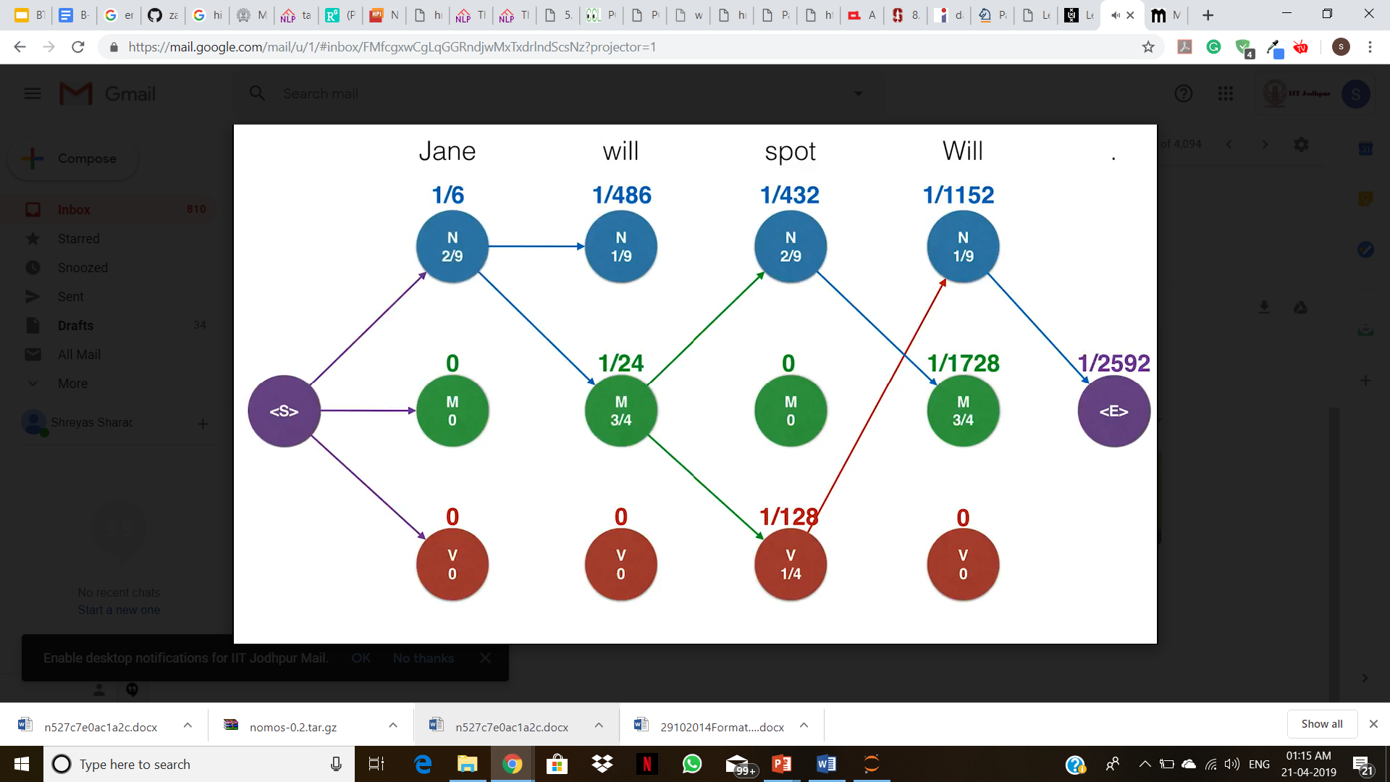
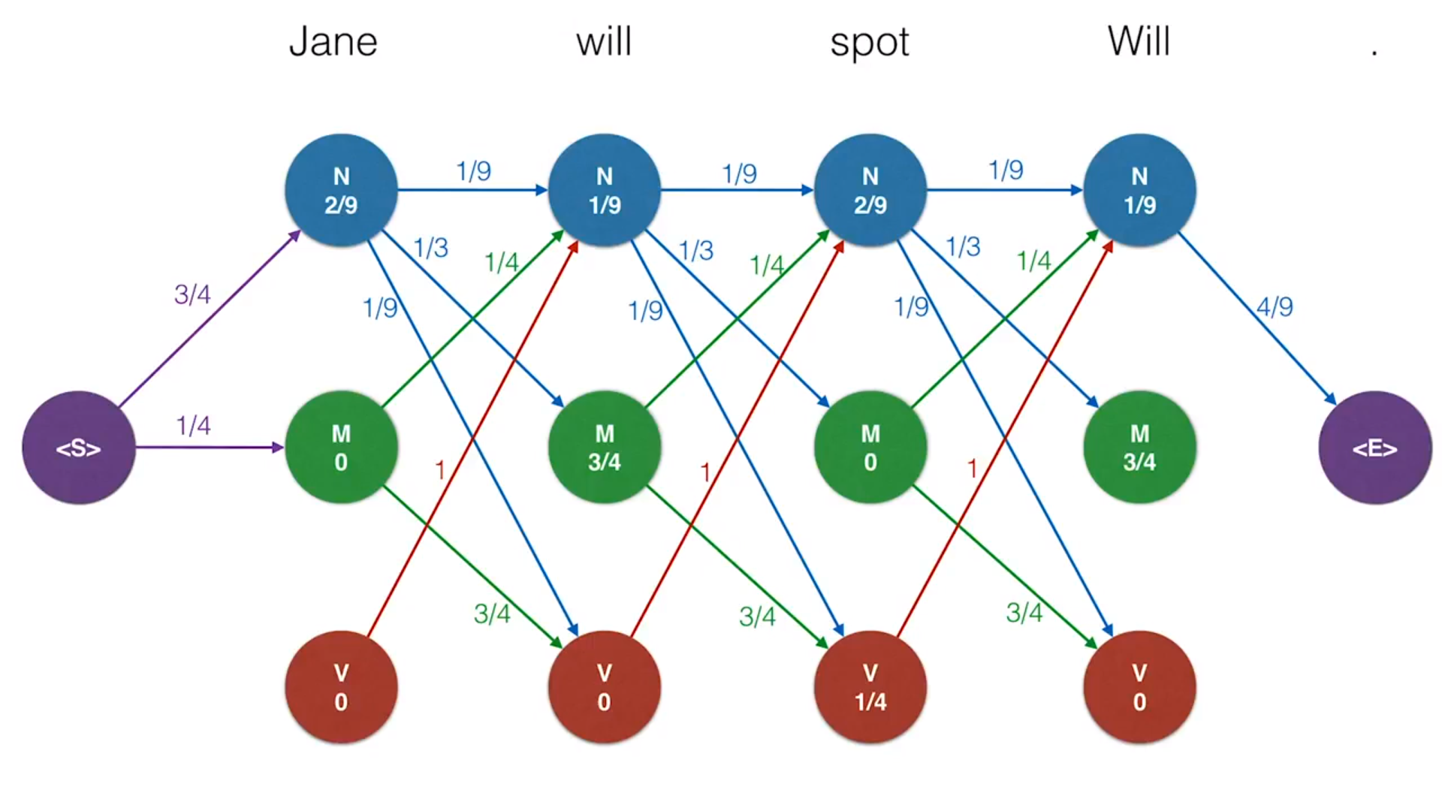

Slide 21
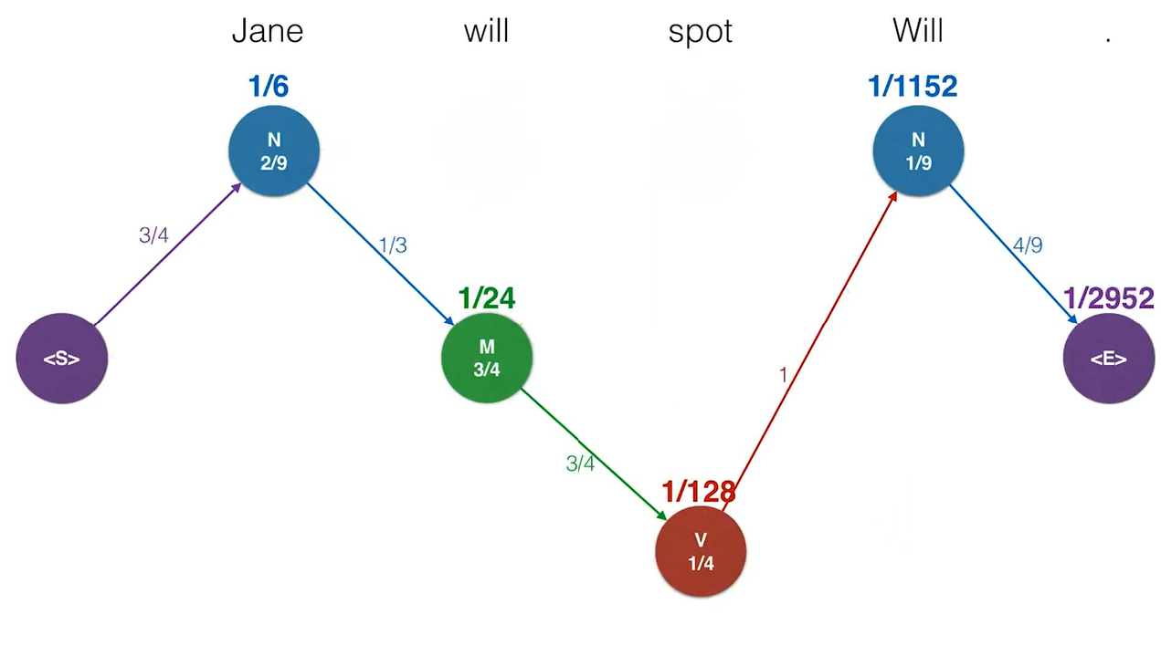

Slide 22
Data sparsity solution
When a new, unknown, ambiguous word ‘w’ arrives, we never have seen any tag with this word while training.
Hence, for all tags t ∈ T: P( w | t ) = 0.
One solution is to define set of rules for these words and combine Rule-based approach here. But again, as discussed above in previous sections, this method is not suitable for Hindi in the current scenario.
So we move towards another technique, called ‘Smoothing’.

Slide 23
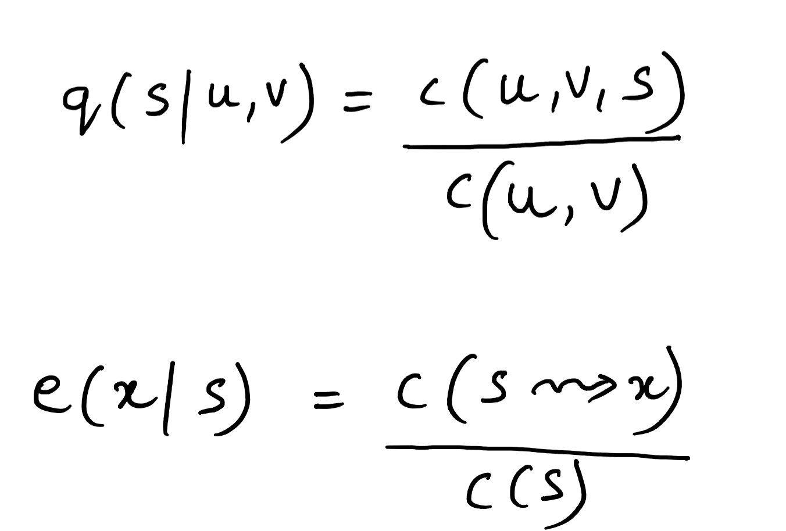
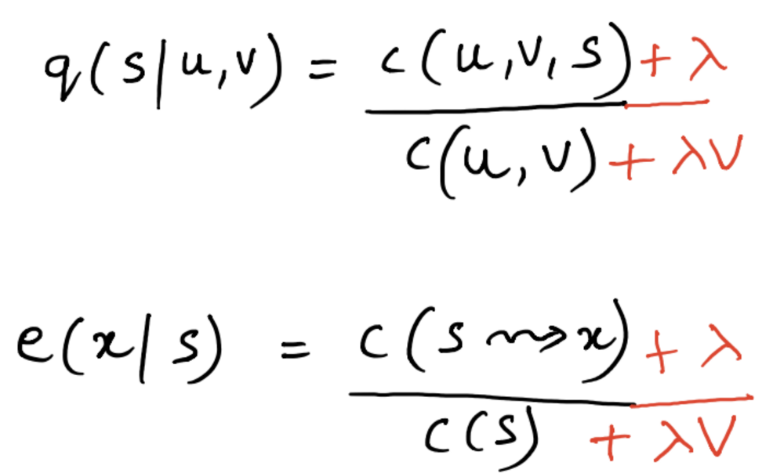
Smoothing
Laplace Smoothing
c(u, v, s) is 0
c(u, v) is 0
We get an unknown word in the test sentence, and we don’t have any training tags associated with it.
Offset Smoothing
To provide a kind of offset or base so that unknown emission probabilities have a kind of reasonable probability in the negative order of 10 according to the words in the corpus.

Slide 24
Decision Tree Model
Disadvantages:
Since each branch in the decision tree splits the training data, the amount of training data available to train nodes lower in the tree can become quite small
They force features to be checked in a specific order, even when features may act relatively independently of one another
Improved Decision Tree Model
We added 6 more morphological features to our model relating to the prefixes and suffixes and improved the accuracy of our model by almost 9%

Slide 25
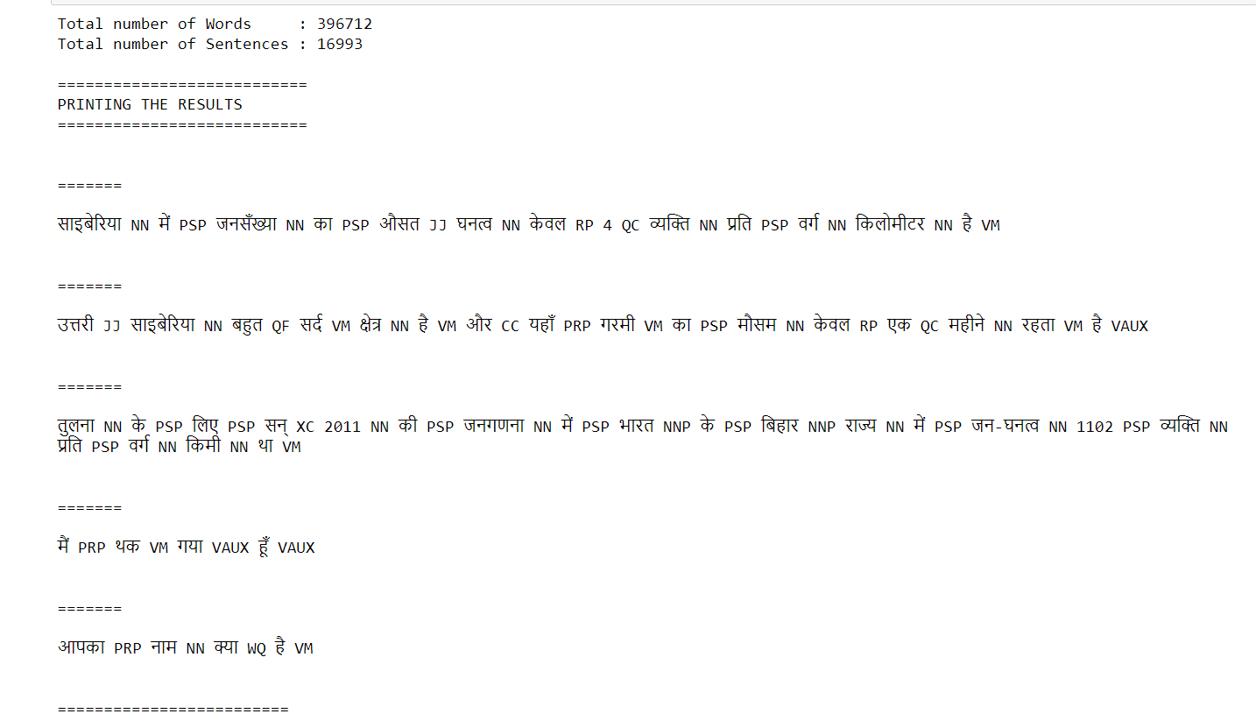
Results - Bigram HMM

Slide 26
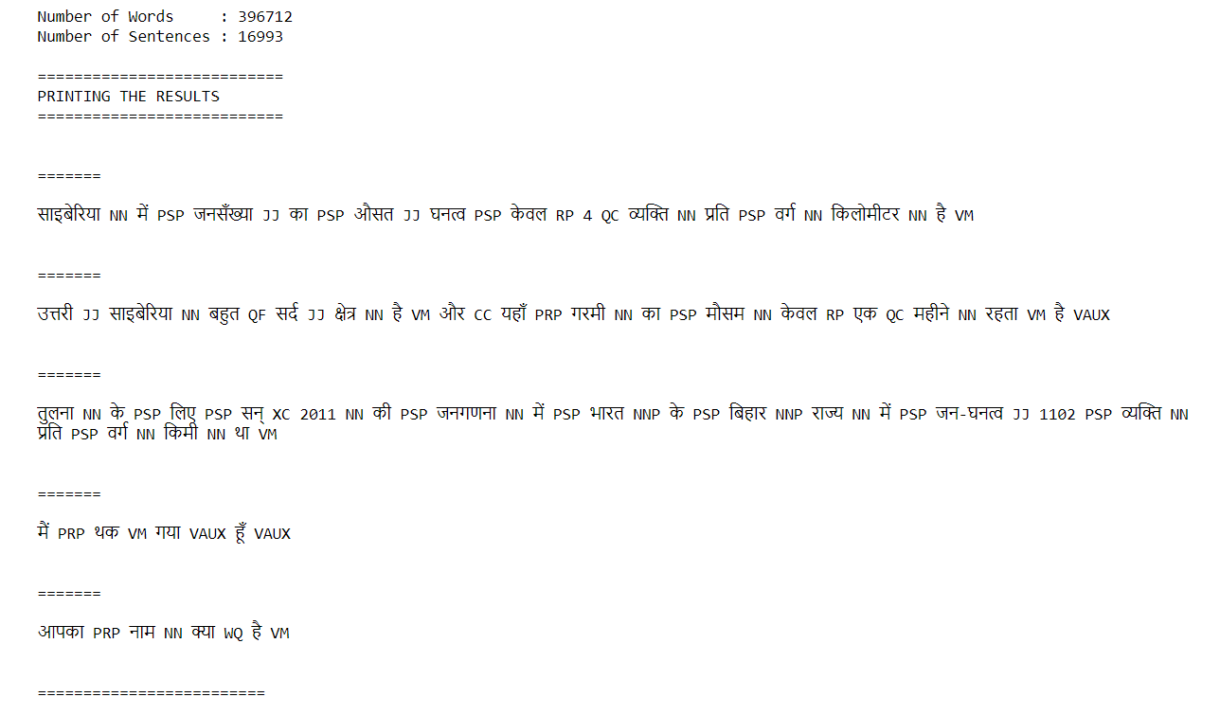
Results - Trigram HMM

Slide 27

Results - Improved Trigram HMM

Slide 28
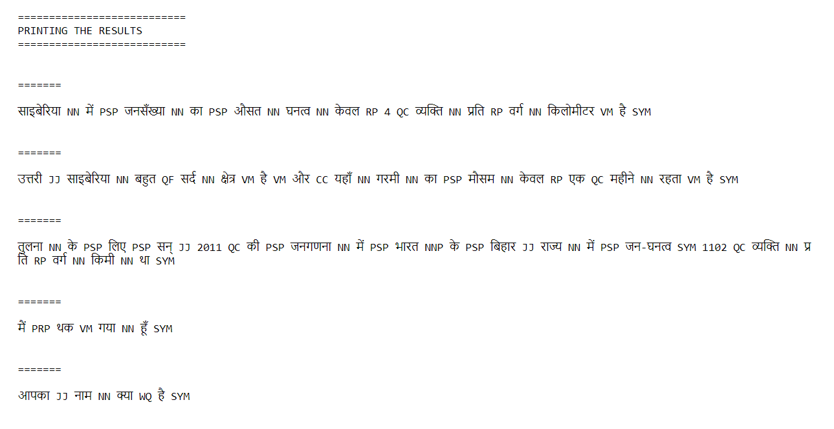
Results - Decision Tree

Slide 29
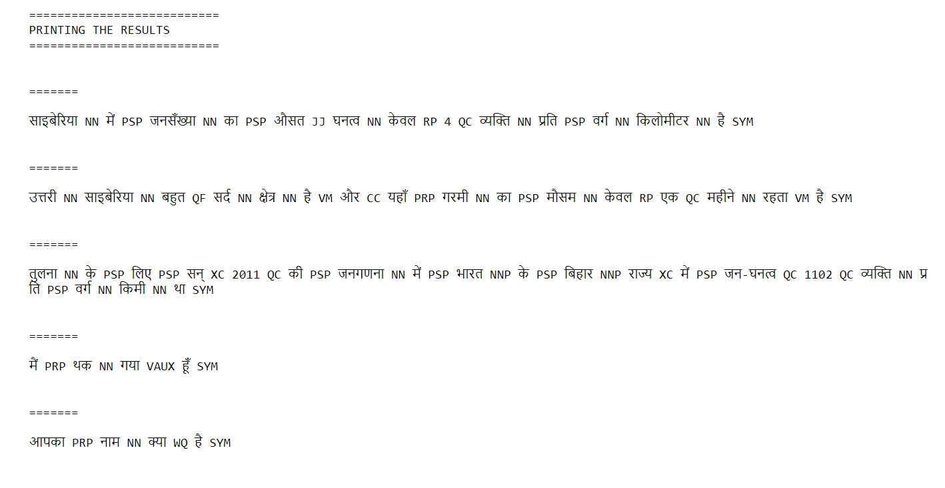
Results - Improved Decision Tree

Slide 30
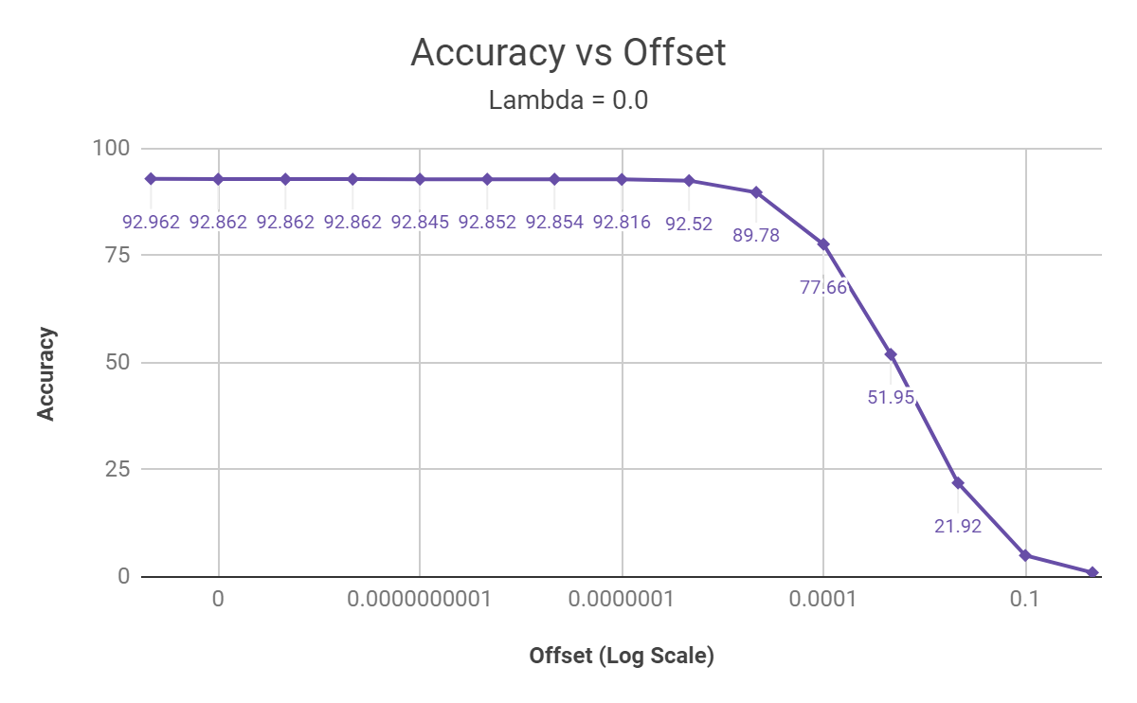
Results
Results for Bigram HMM
< about smoothing >

Slide 31
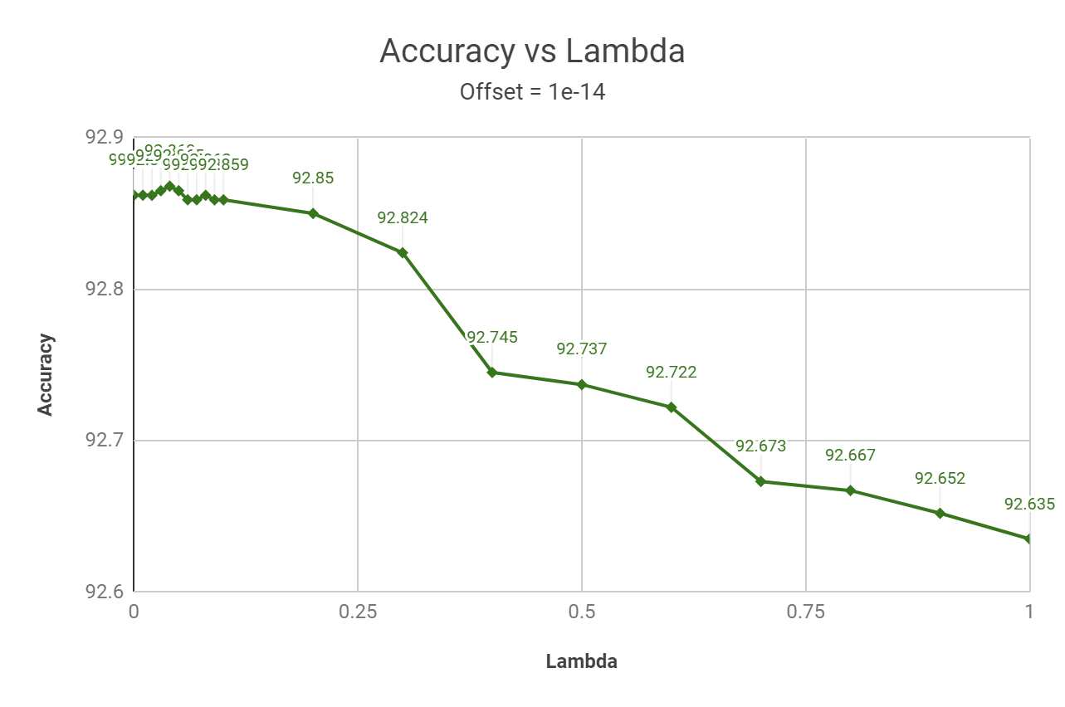
Results
Results for Bigram HMM

Slide 32
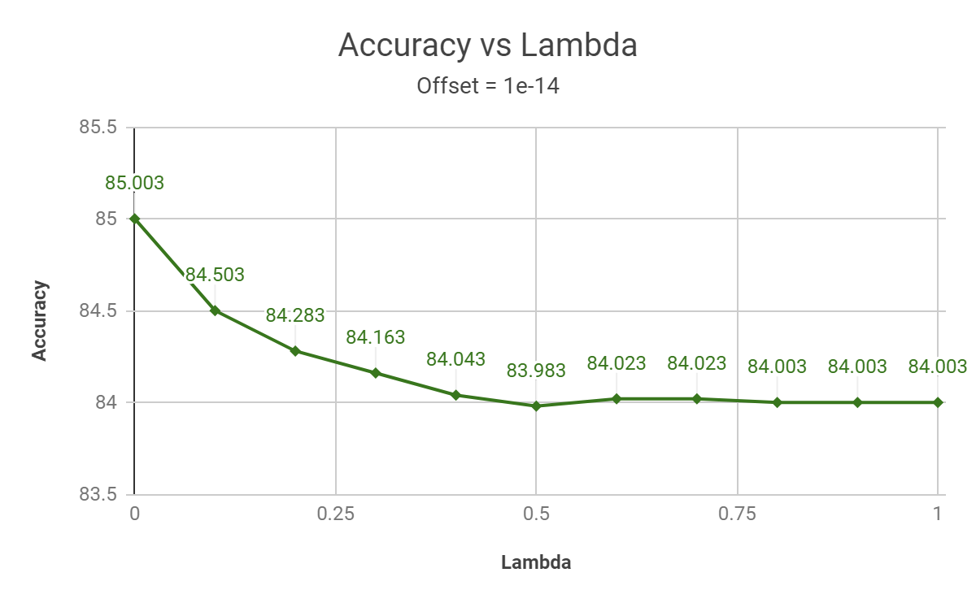
Results
Results for Trigram HMM

Slide 33
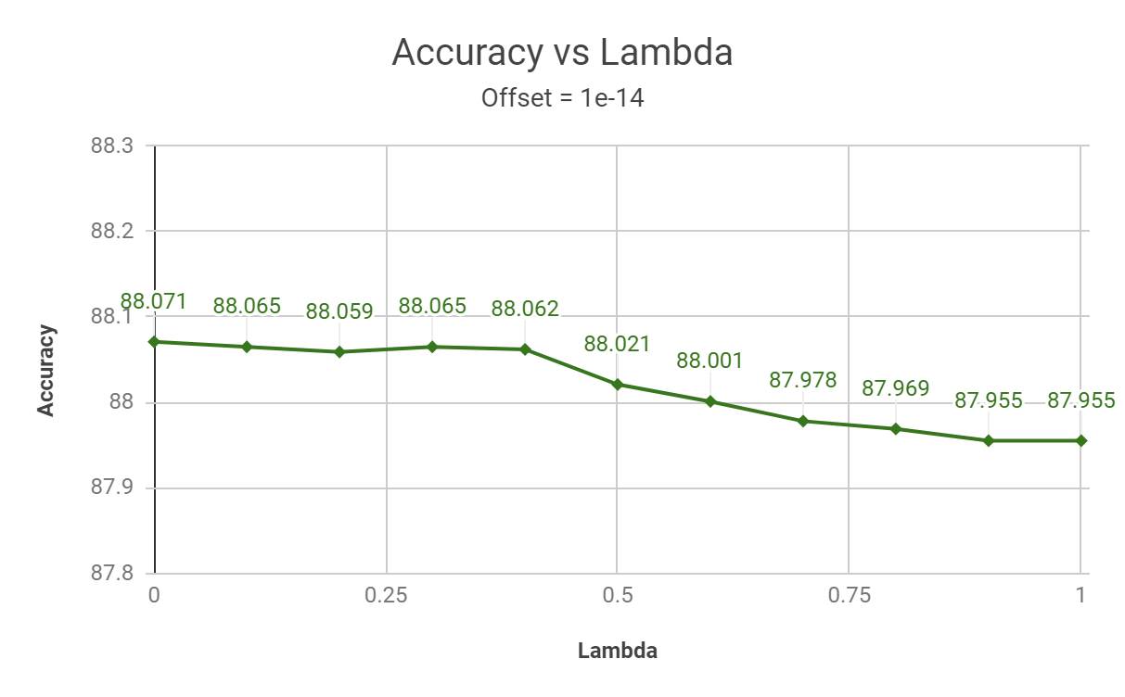
Results
Results for Improved Trigram HMM

Slide 34
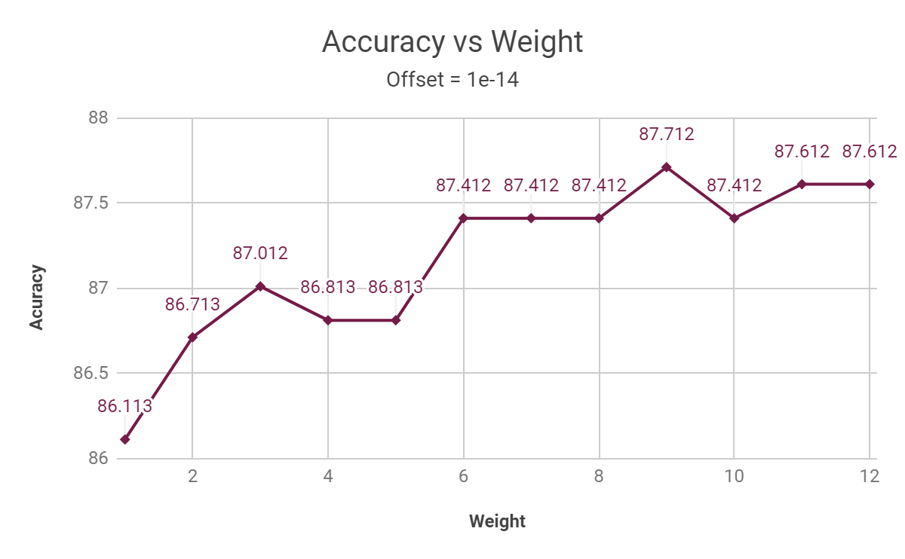
Results
Results for Improved Trigram HMM
9
Best weight

Slide 35
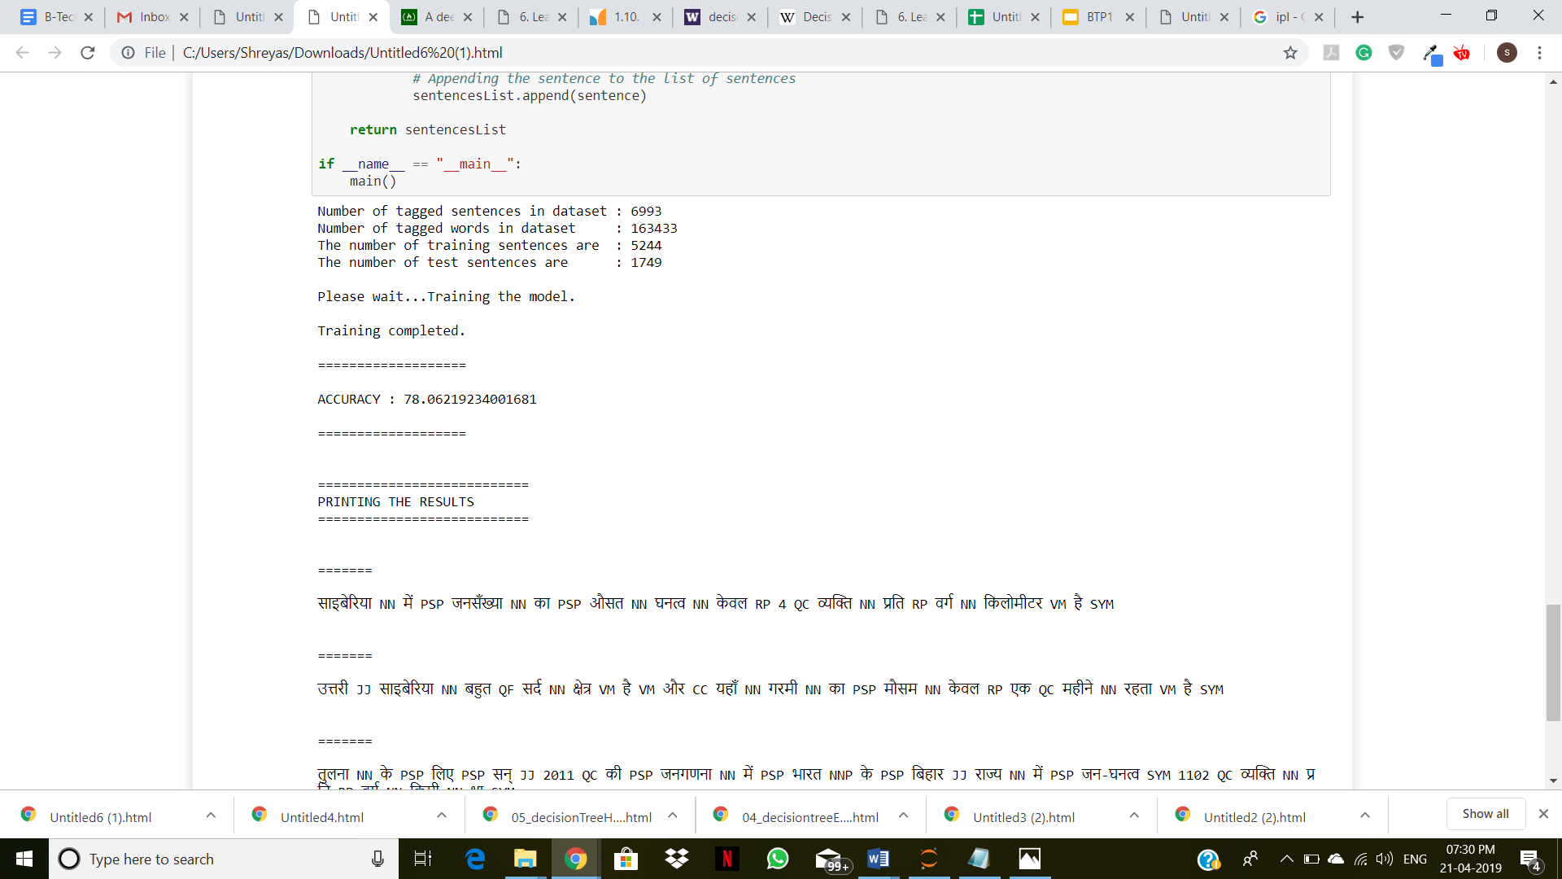
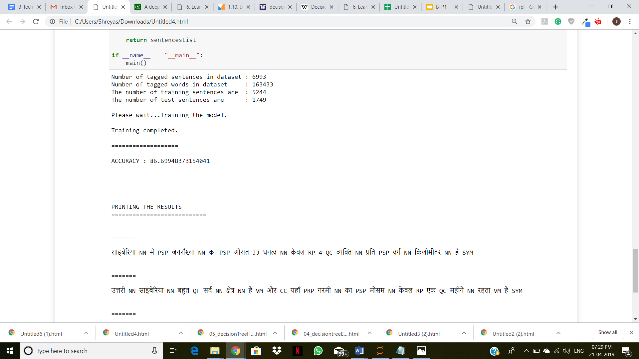
Accuracy Comparison
Decision Tree
Accuracy: 78.062
Training Sentences: 5244
Test Sentences: 1749
Improved Decision Tree
Accuracy: 86.699
Training Sentences: 5244
Test Sentences: 1749

Slide 36
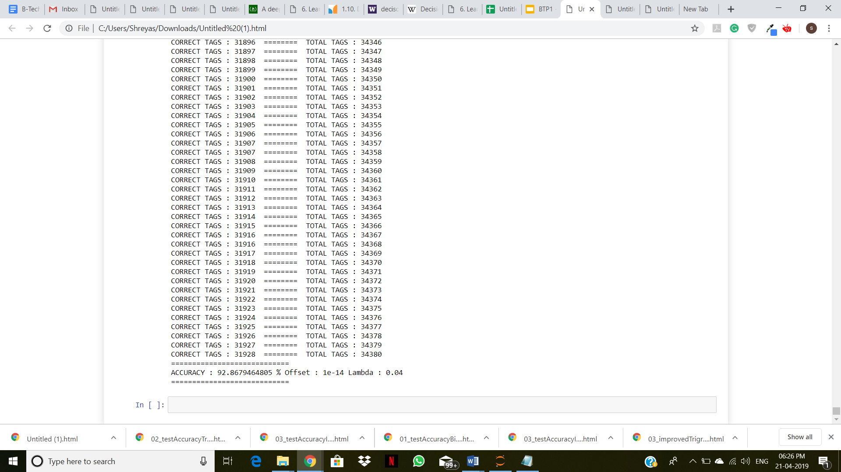
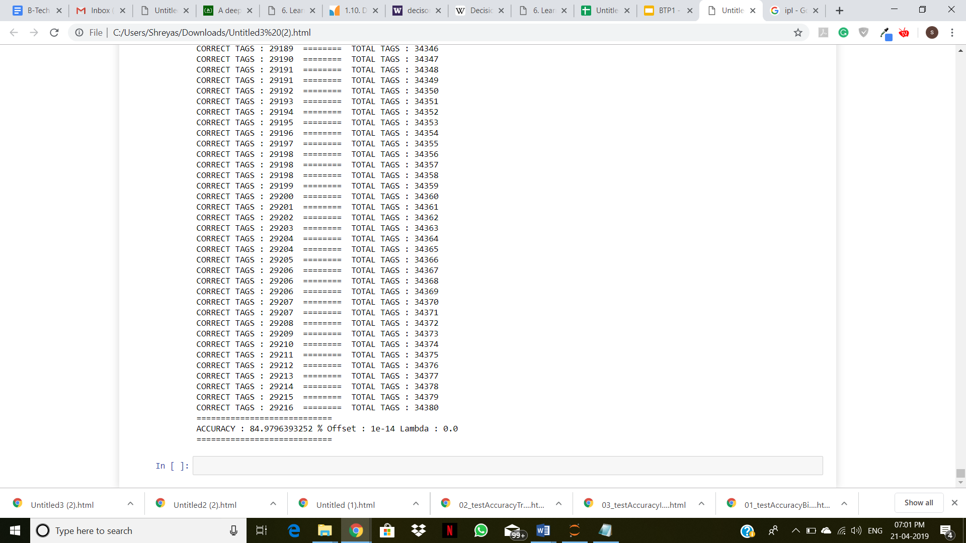
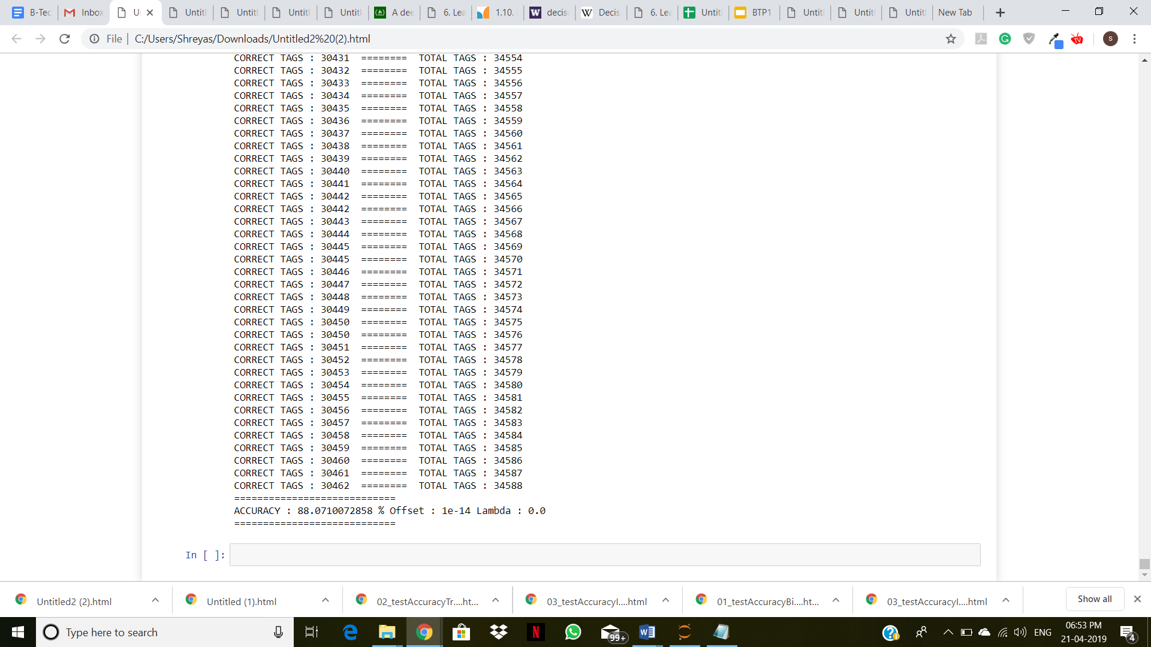
Accuracy Comparison
Bigram HMM
Accuracy: 92.867
Correct Tags: 31928
Total Tags: 34380
Trigram HMM
Accuracy: 84.979
Correct Tags: 29216
Total Tags: 34380
Improved Trigram HMM
Accuracy: 88.071
Correct Tags: 30462
Total Tags: 34588

Slide 37
Future Work
We can extend this approach to construct a Hybrid Part-of-Speech Tagger for Hindi using both, Rule based Approach and Stochastic Methods.
We can implement different, efficient Smoothing techniques, like Good Turing Smoothing, Katz Smoothing etc. and increase accuracy even further.
We can improve the Dataset by extending the size of the corpus and increase frequencies for individual tags. Also we can increase different possibilities of trigrams, because earlier, of the 10648 possibilities, only around 4500 were available in the dataset.

Slide 38
Questions?
Thank You

